Slide 1

Middle East Technical University
Department of Electrical and Electronics Engineering
Modeling and Simulation
with
MATLAB/Simulink
Mesut Uğur
ugurm@metu.edu.tr
24.11.2017

Slide 2


Önce reklamlar…
http://power.eee.metu.edu.tr/

Slide 3

What is it?
Graphical programming environment
Modeling, simulation, analysis
Multi-domain dynamic systems
Model based design (embedded systems)
Rich library
Integration with the rest of MATLAB

Slide 4
Why is it?
Flexible: Integration with MATLAB !
Export data to use in MATLAB
Import data to simulate from MATLAB
Multi-software simulation
You can imitate many things !
Integrated simulation (Multi-domain systems)
Widely used (Google it !)

Slide 5
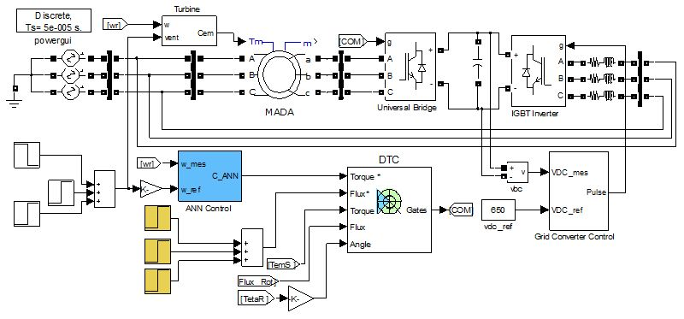
Examples
Wind Energy System

Slide 6
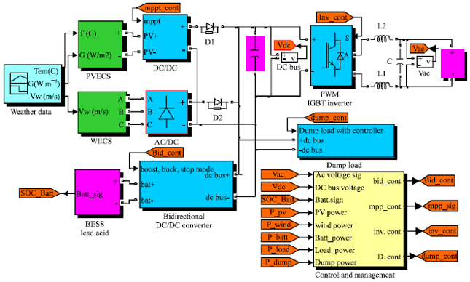
Examples
Solar Energy System

Slide 7
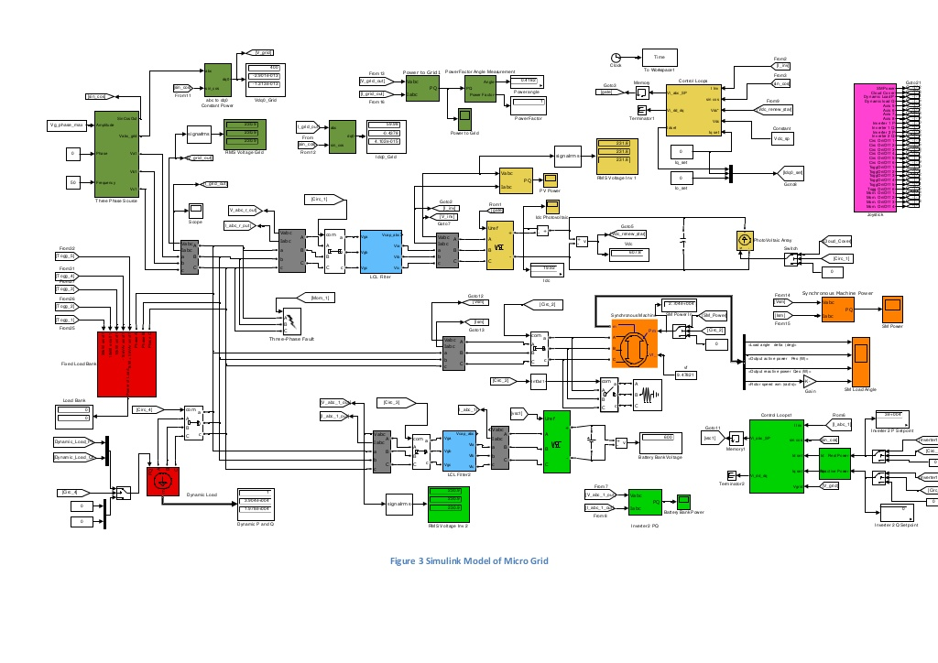
How complex ?

Slide 8
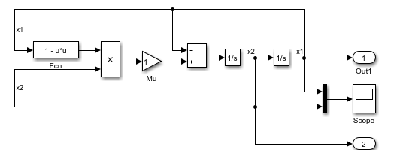
How does it work ?
When you hit RUN;
Compilation: Model is converted to an executable form
Allocation of memory (signals, states, run-time parameters)
Block priorities
Order of execution
Simulation loop (compute states and outputs)
Simulation step time: Variable or fixed

Slide 9
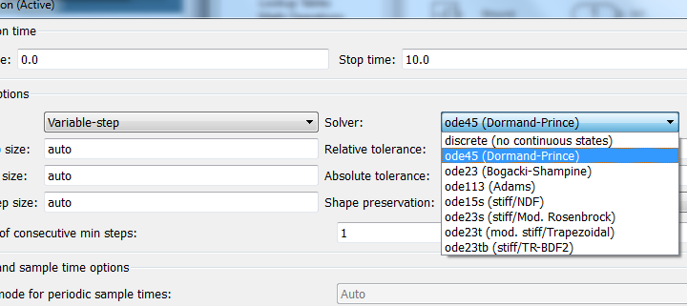
Solvers
Fixed step, variable step
Continuous, discrete
Discrete signals: Difference equations
Continuous signals: Numerical integration (ODE)

Slide 10
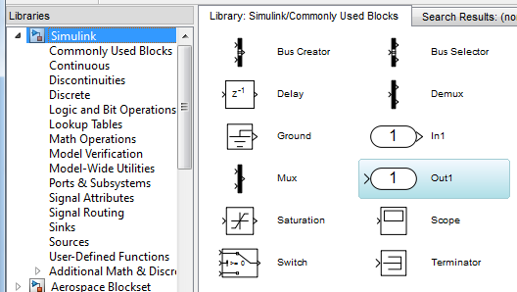
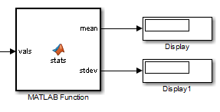
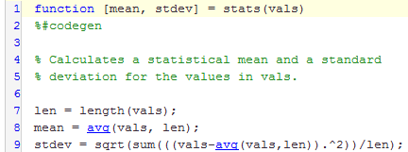
Libraries
Logic, math, control, source, display, if/switch, in/out
User defined functions
Digital signal processing, communication, neural network, optimization, system identification
SimRF, SimElectronics, SimMechanics, SimPowerSystems

Slide 11
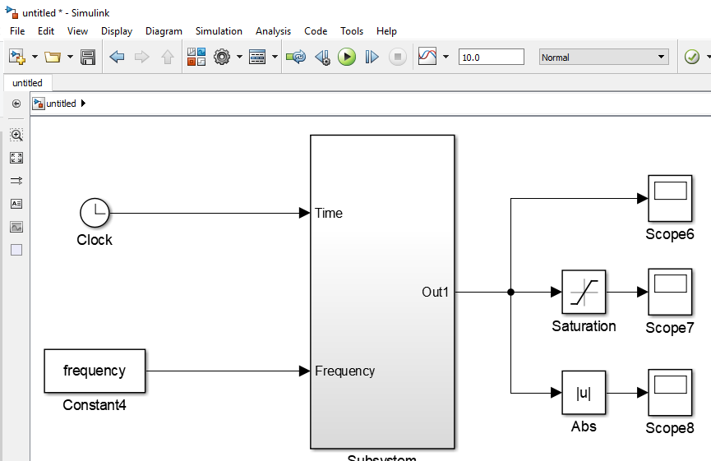
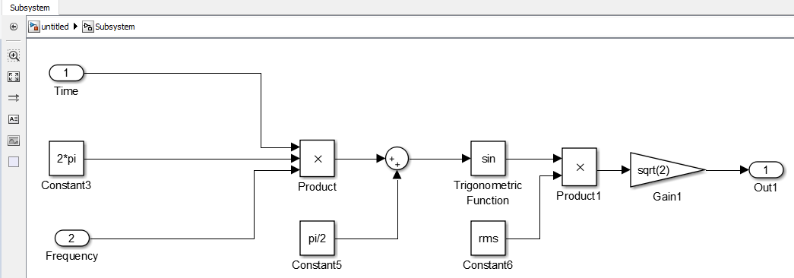
Models

Slide 12
Procedure
Model your system on paper
Construct your model on Simulink
Results, Analysis, Design etc…

Slide 13
Content
PART I
Very first model
Common blocks
Transfer functions
PART II
Electrical systems
Single phase rectifiers
Three-phase rectifiers
Controlled rectifiers

Slide 14

Examples

Slide 15
Examples
PART I
Intro: 10’
What is Simulink?
Why Simulink?
How does it work?
Very first model: 15’
Library
Config parameters
Compile & run
Scope
Common blocks: 15’
Data type - relay
Switch
Integral
Create voltage
Transfer functions: 10’
Plant - loop
P, PI, PID
Notch filter
PART II
Electrical systems: 10’
Powergui
Source, load, measurements
Step time
Single phase rectifiers: 15’
Diode
R, RL load
Universal bridge
RMS, mean
Three-phase rectifiers: 15’
Three-phase system
Fourier
THD, power factor
Controlled rectifier: 15’
Thyristor
Pulse generator
DC and AC power
FFT tool

